Slide 1
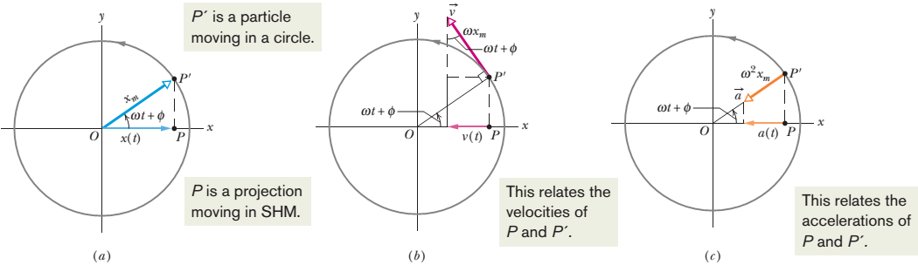
Lecture 15
Simple Harmonic Motion and Uniform Circular Motion:
Simple harmonic motion is the projection of uniform circular motion on a diameter of the circle in which the circular motion occurs.
Figure 15-15 (a) A reference particle P’ moving with uniform circular motion in a reference circle of radius x_{m}. Its projection P on the x axis executes simple harmonic motion. (b) The projection of the velocity of the reference particle is the velocity of SHM. (c) The projection of the radial acceleration of the reference particle is the acceleration of SHM.

Slide 2
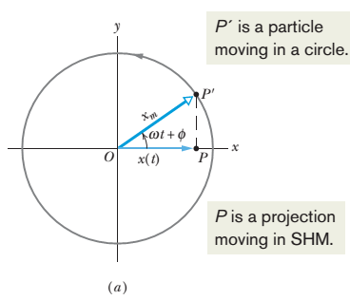
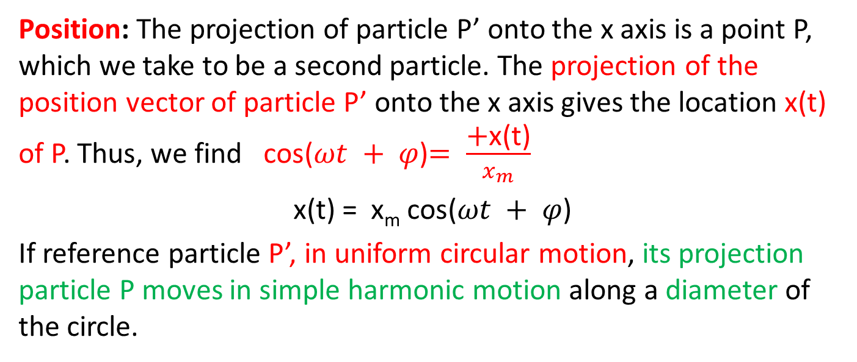
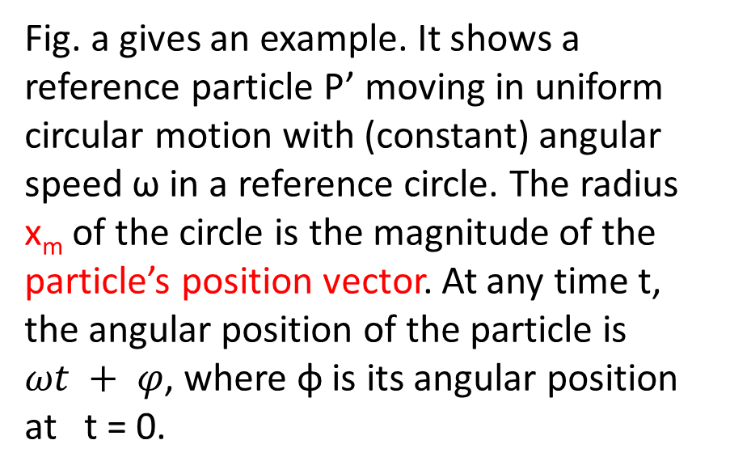
Fig. a gives an example. It shows a reference particle P’ moving in uniform circular motion with (constant) angular speed ω in a reference circle. The radius x_{m} of the circle is the magnitude of the particle’s position vector. At any time t, the angular position of the particle is $ωt + φ$, where φ is its angular position at t = 0.
Position: The projection of particle P’ onto the x axis is a point P, which we take to be a second particle. The projection of the position vector of particle P’ onto the x axis gives the location x(t) of P. Thus, we find cos($ωt + φ$)$= \frac{\text{+}\text{x}\text{(}\text{t}\text{)}}{x_{m}}$
x(t) = x_{m} cos($ωt + φ$)
If reference particle P’, in uniform circular motion, its projection particle P moves in simple harmonic motion along a diameter of the circle.

Slide 3
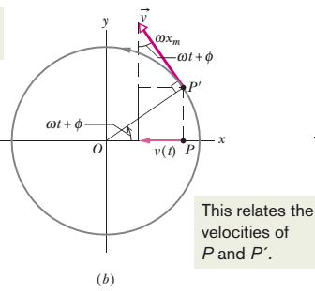
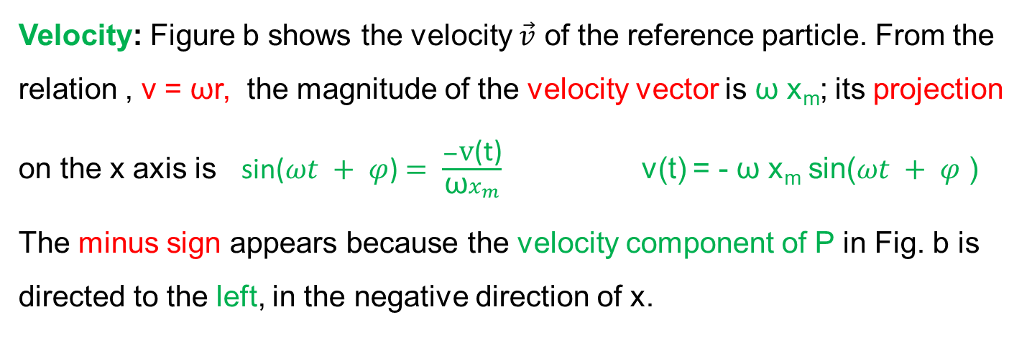
Velocity: Figure b shows the velocity $\vec{v}$ of the reference particle. From the relation , v = ωr, the magnitude of the velocity vector is ω x_{m}; its projection on the x axis is sin($ωt + φ$)$= \frac{−\text{v}\text{(}\text{t}\text{)}}{{\text{ω}x}_{m}}$ v(t) = - ω x_{m} sin($ωt + φ$ )
The minus sign appears because the velocity component of P in Fig. b is directed to the left, in the negative direction of x.

Slide 4
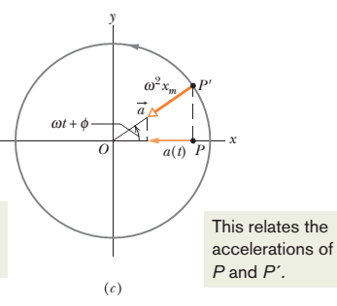
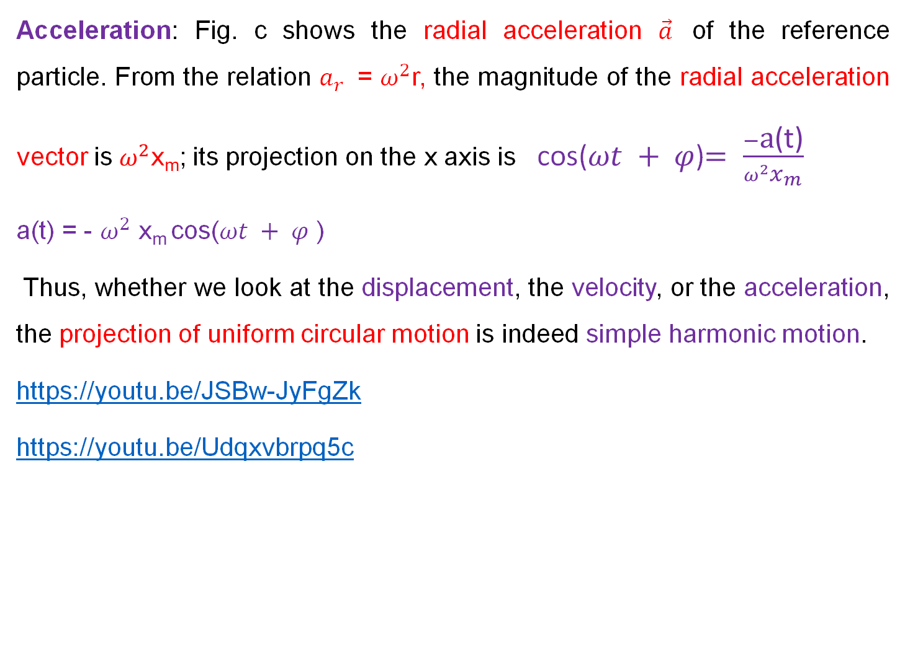
Acceleration: Fig. c shows the radial acceleration $\vec{a}$ of the reference particle. From the relation $a_{r }$= $ω^{2}$r, the magnitude of the radial acceleration vector is $ω^{2}$x_{m}; its projection on the x axis is cos($ωt + φ$)$= \frac{−\text{a}\text{(}\text{t}\text{)}}{{ω^{2}x}_{m}}$
a(t) = - $ω^{2}$ x_{m} cos($ωt + φ$ )
Thus, whether we look at the displacement, the velocity, or the acceleration, the projection of uniform circular motion is indeed simple harmonic motion.
https://youtu.be/JSBw-JyFgZk
https://youtu.be/Udqxvbrpq5c

Slide 5
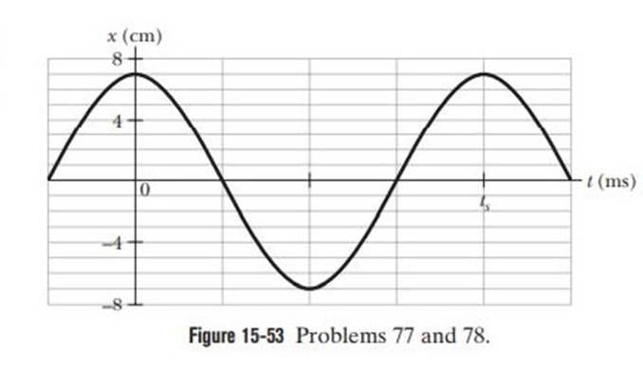

77: Figure 15-53 gives the position of a 20 g block oscillating in SHM on the end of a spring. The horizontal axis scale is set by t_{s} = 40.0 ms. What are (a) the maximum kinetic energy of the block and (b) the number of times per second that maximum is reached? (Hint: Measuring a slope will probably not be very accurate. Find another approach)

Slide 6
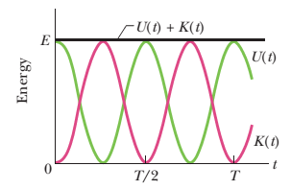

_{m = 20 gm = 0.020 kg}
x_{m}= 7 cm = 0.07 m
_{T = ts = 40 ms = 0.040 s}
x(t) = x_{m} cos($ωt + φ$)
v(t) = $\frac{dx}{dt}$ = $\frac{d}{dt}$ {x_{m} sin($ωt + φ$)}
= - ω x_{m} sin($ωt + φ$ )
v_{m} = ωx_{m}
$ω$ = $\frac{2π}{T}$ = $\frac{2π}{0.040}$ = 157.08 rad/s
$K_{max}=\frac{1}{2}mv_{m}^{2}$ = $\frac{1}{2}m$(${{ωx}_{m})}^{2}$= $\frac{1}{2}mω^{2}x_{m}^{2}$
= $\frac{1}{2}(0.020){(157.08)}^{2}$(${0.07)}^{2}$
= 1.20 J
(b) $f$ = $\frac{1}{T}$ = $\frac{1}{0.40}$ = 25 Hz or [25 cycles per s]
From figures:
v_{m}
v_{m}
K_{max}
K_{max}
1 cycle per second = 1 Hz , the maximum KE is reached 2 times
25 cycles per second=25 Hz ,the maximum KE is reached 2x25 times or 50 times

Slide 7
78: Figure 15-53 gives the position x(t) of a block oscillating in SHM on the end of a spring (t_{s} = 40.0 ms). What are (a) the speed and
(b) the magnitude of the radial acceleration of a particle in the corresponding uniform circular motion?

Slide 8
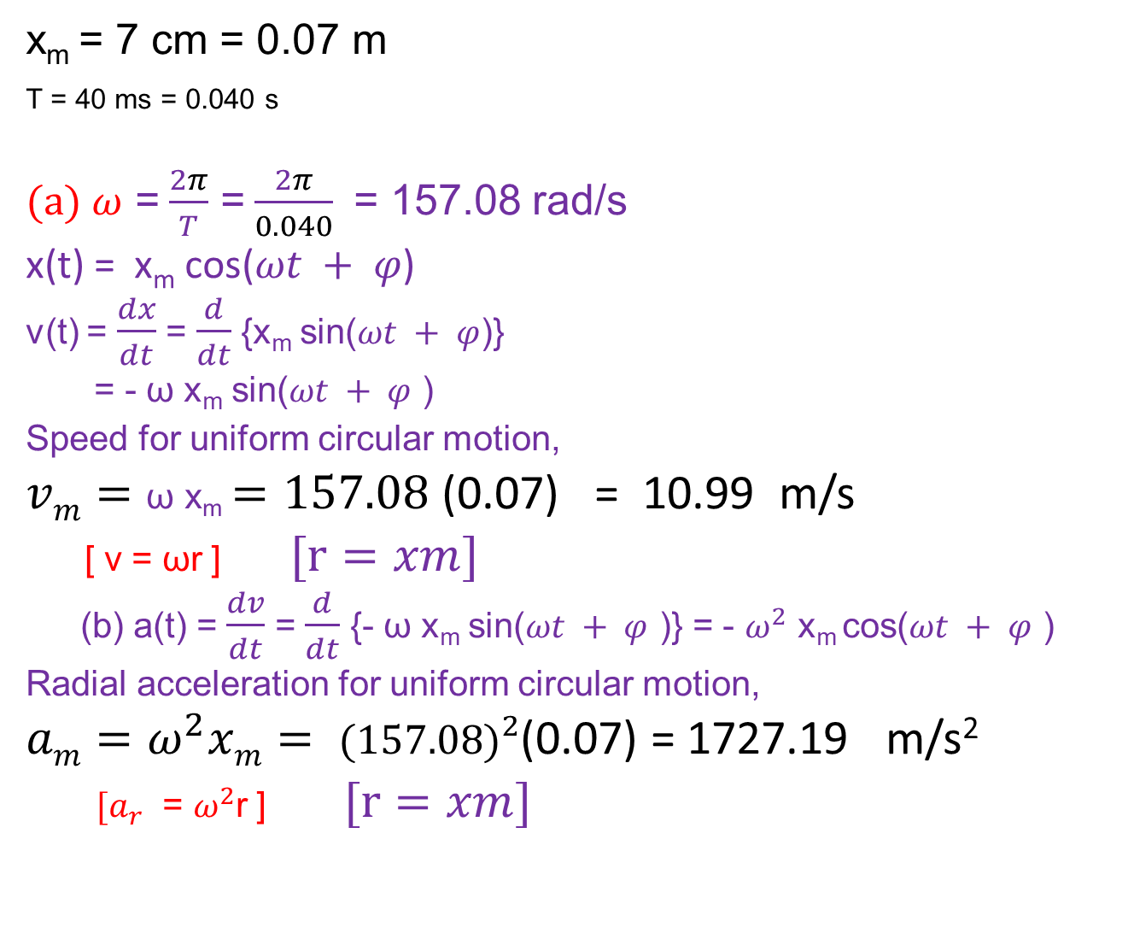
x_{m} = 7 cm = 0.07 m
_{T = 40 ms = 0.040 s}
(a) $ω$ = $\frac{2π}{T}$ = $\frac{2π}{0.040}$ = 157.08 rad/s
x(t) = x_{m} cos($ωt + φ$)
v(t) = $\frac{dx}{dt}$ = $\frac{d}{dt}$ {x_{m} sin($ωt + φ$)}
= - ω x_{m} sin($ωt + φ$ )
Speed for uniform circular motion,
$vm=\text{ω} \text{x}\text{m}=157.08$(0.07) = 10.99 m/s
[ v = ωr ] $[r=xm]$
(b) a(t) = $\frac{dv}{dt}$ = $\frac{d}{dt}$ {- ω x_{m} sin($ωt + φ$ )} = - $ω^{2}$ x_{m} cos($ωt + φ$ )
Radial acceleration for uniform circular motion,
$am=ω^{2}xm= {(157.08)}^{2}$(0.07) = 1727.19 m/s²
${ [a}_{r }\text{= }ω^{2}\text{r}$ ]$[r=xm]$

